Slide 1
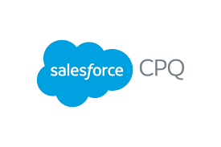

Salesforce CPQ Overview
Trainer:
H R, Chandana

Slide 2
Objectives
Introduction to Salesforce CPQ
Quote Management
Select Products
Calculate Prices
Generate PDF Quotes
Manage Contracts and Renewals

Slide 3
What is the basic sales process every company follows??
Leads are potential customers(ppl/company) who might be interested in your service or product
You campaign through Social media marketing/mails
Prospecting and qualification
Once identified give presentation to the leads about your services/products and what are the benefits of having them
Negotiation
Once the negotiations are complete and discounts are approved you close the deal
Prospect and qualify the leads who can bring business
Leads who like the products would ask for discount and here you have to negotiate about the deal
Lead Generation
Presentation and Proposal
Close

Slide 4
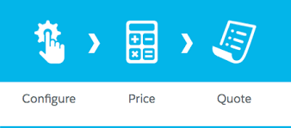
Introduction to Salesforce CPQ
CONFIGURE
What does the customer want to buy ?
Pick out the products or services which the customer wants to buy.
PRICE
How much do these products cost ?
Find the right price (Base Price) for the products.
QUOTE
How can we give the customer details about the sale ?
Generate a PDF with all the quote details.

Slide 5
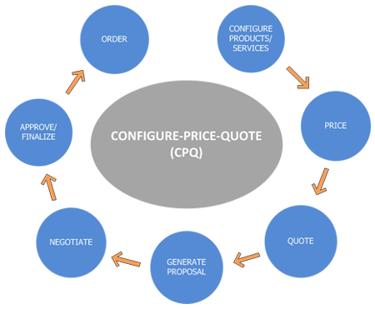
What does CPQ actually do ?
With Salesforce CPQ, you and your sales team generally known as Sales Rep can creates opportunity and quote linked to the opportunities quickly, with minimal effort and minimal error.
Salesforce CPQ uses smart rules to make sure you sell related products together and to prevent incompatible products from ending up on the same quote.
You have to find the right price for the products (which is generally fetched from Price Book) you’re selling, and Salesforce CPQ does all the calculation including different types of discounts applied on it. After the discount is applied the whole quote is sent for approval before sending it to customers.
CPQ enables you to generate a PDF with all quote details and send it to your customer with just one click.

Slide 6
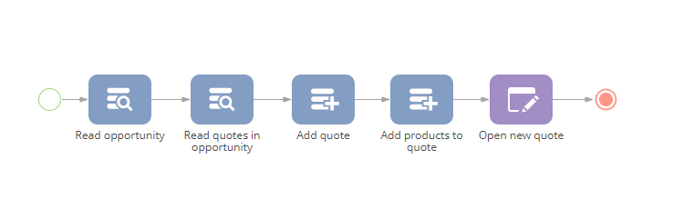
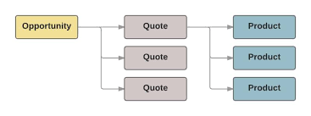
Quote Management
A Quote is a document that contains information about the products and services your customer wants to buy.
However many quotes your opportunity contains, only one can be designated as primary, which means it has a special relationship with the opportunity.
The Products related list also updates with the products from your quote. If you later make a different quote primary, your opportunity automatically updates to reflect the new details.

Slide 7
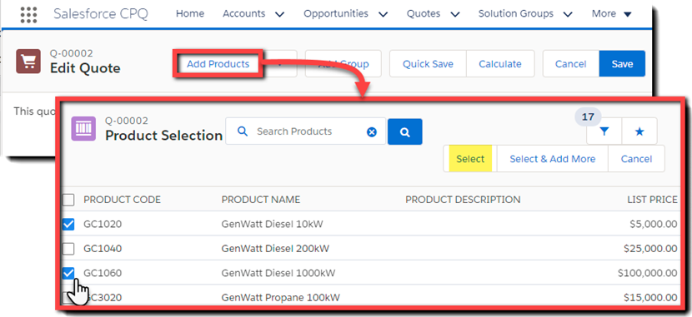
Select Products
Salesforce CPQ simplifies product selection so you create quotes correctly the first time. After you create a quote, you add products. Salesforce CPQ makes it easy.
You click Add Products to display a list of active products, and you simply check which products you want to include on the quote.
This list of products updates whenever new products are created or old products are retired. Customizable filters help you find the products you’re looking for. Your Salesforce admin can group products into categories, such as Product Family, for even easier product selection.

Slide 8
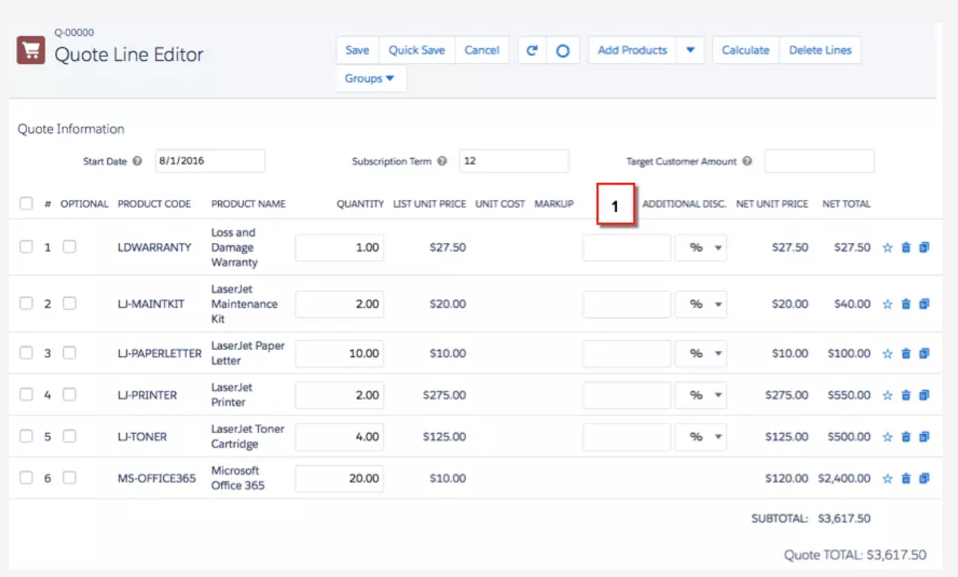
Calculate Prices
Salesforce CPQ pricing calculator helps you have the correct pricing to present the quotes that are valid and does not include any manual calculation errors.
When you add products to a quote, your quote automatically calculates the product prices. After that, any updates to your quote, such as changes in the quantity of the products, are reflected in the quote pricing.
A Pricebook gives you a list price for all products. OOB salesforce functionality, CPQ pricing method and calculations helps us to get the prices.
Salesforce CPQ provides several ways to discount prices for your customers. You can set discounts across an entire quote or on individual products and product groups.

Slide 9
Generate PDF Quotes
1
A typical PDF quote contains a list of products and services you’re quoting and the prices and discounts on those items
2
Any important terms and conditions are also in the PDF document. Depending on the products and services being quoted, you sometimes provide additional specification documents for review.
3
There is a lot of information to display in this PDF document. What information to include, and when or how to present it, can differ from customer to customer. The PDF document is dynamic and hence salesforce CPQ can dynamically display several different pieces of information about your quote.

Slide 10
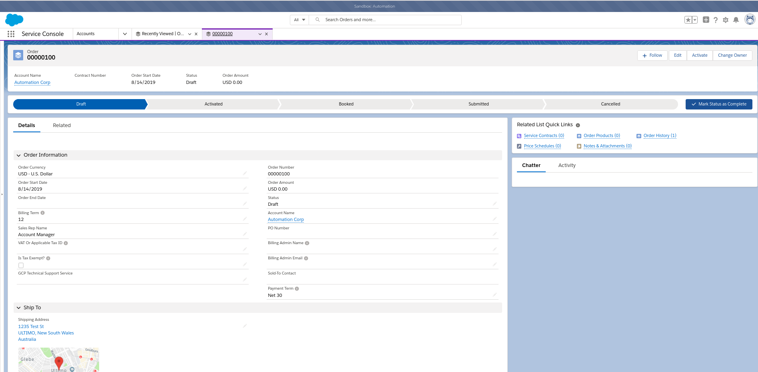
Generate Order
Order generation marks the entry for contract generation.
Order is always created once the quoting process is completed.

Slide 11
Manage Contracts And Renewals
1
2
3
A Contract is a duration of the subscription products which has start and end date defined. Eventually the contract will end, and you’ll have an opportunity to create a quote for a renewal sale.
Salesforce CPQ can automatically create renewal opportunities and quotes for subscription products before your customer’s contract ends. Your renewal opportunity contains all subscription items with quantities from the existing contract.
When your renewal opportunity is ready for a final quote, Salesforce CPQ can automate that too. The new quote pulls in all added subscription products and any updated pricing. After Salesforce CPQ creates the new quote, you can edit it and add more products or services if you want.

Slide 12
Thank you !!

